Slide 1
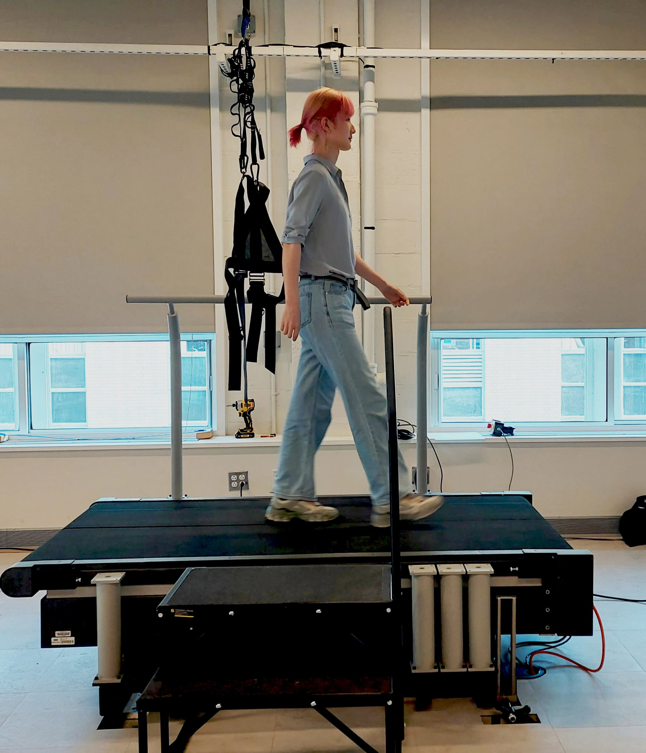
Spring Semester Report:
MATLAB App for instrumented treadmills: COM tracking and self-pacing control
#change this picture to treadmill pic
Student: Guangping Liu

Slide 2
Outline
Motivation
Previous Work
SPT App for PC
Communication between treadmill and MATLAB
Sagittal Kalman Filter
Speed Controller
Lateral Kalman Filter
MATLAB App Designer
Notes:
30 seconds

Slide 3
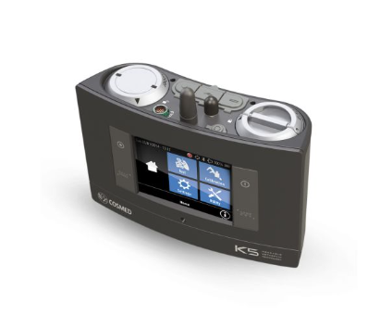
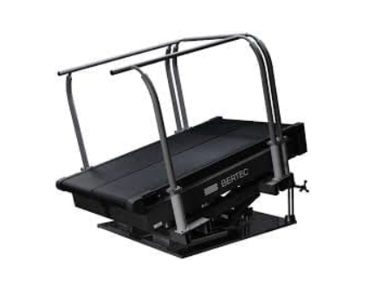
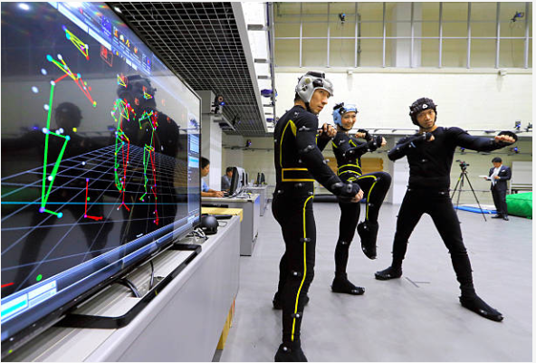
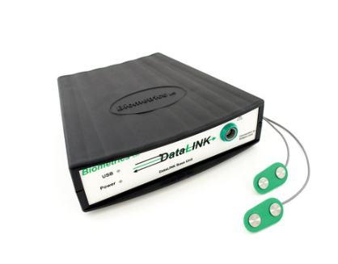
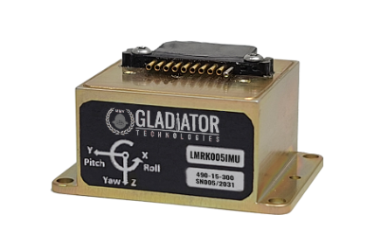
Motivation
GRF
Energy consumption
kinematics
Motion Capture System
Metabolic measurement system
Treadmill
kinematics
Muscle activation
IMU
Electromyography(EMG)

Slide 4
Motivation
COM…
-> side-to-side: stability measure(ex.+papers)
-> fore aft: self-paced treadmill

Slide 5
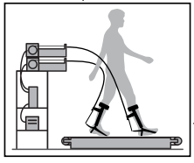
Motivation
Test assistive devices
A self-pacing treadmill
Other self-paced treadmills…(motion capture)
Free walking speed
Preferred walking speed
Rehabilitation
Test assistive devices
Preferred walking speed
A self-pacing treadmill
Rehabilitation

Slide 6
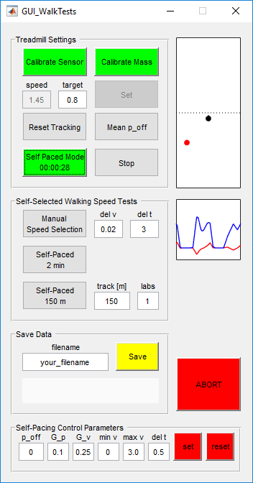
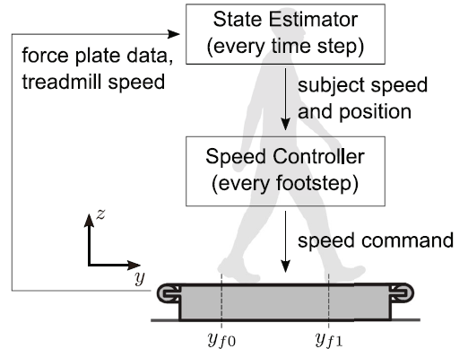
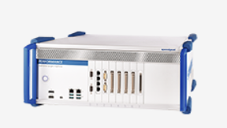
Previous Work
Song, Choi & Collins, JNER, 2020

Slide 7
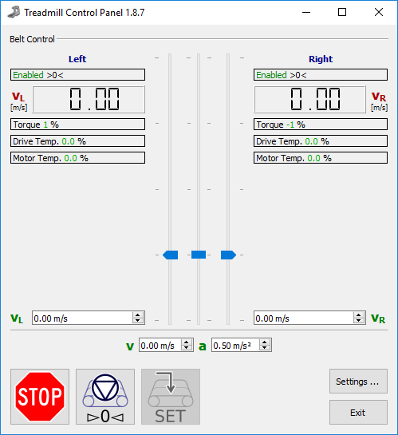
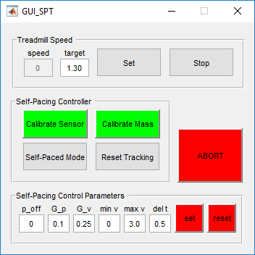
Previous Work
Self-pacing Test
Walking Test
Notes:
4 mins

Slide 8
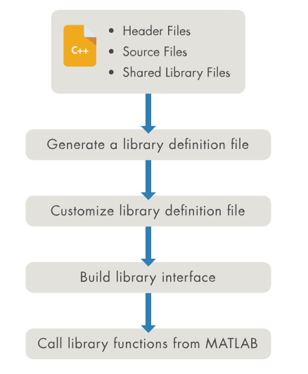

SPT App: communication
Why do we need the communication?
Kick Speedgoat out of our working flow
How do we do it?
mex function
adaptor/ Call C from Matlab
Call C++ from Matlab
Live Code definition file
Generate Interface
Communication
Data stream
Remaining Problems
Some functions doesn’t work
Break down
MATLAB Support
Notes:
2 mins
Why do we need the communication?
-we wanna simplify the equipment needed in research so we want to remove speedgoat from our list.
What we have:
-Bertec SDK
-Matlab
How do we do it?
-mex function
-adaptor/Call C from Matlab
-Call C++ from Matlab:
-Live Code definition file（talk with plots)
-interface
-result:use functions from SDK to call data from the treadmill
Remaining Problems
Some functions doesn’t work
Fail to access the number of belts from data frame
Break down
Information from matlab
Last SDK

Slide 9
SPT App: State estimator
Kalman Filter for Com speeds and positions
Target:
Input: accelerations from ground reaction force(fy)
Output: com positions(p), com speeds(v)
Notes:
1 min
Clarify why do we need Kalman filter:
-state estimator: com positions and speeds to speed controller
-input is the grf
-out put

Slide 10
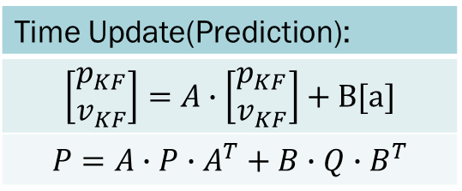
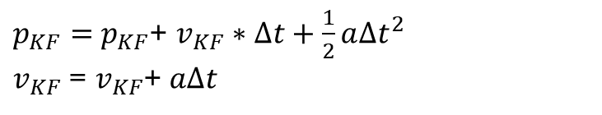
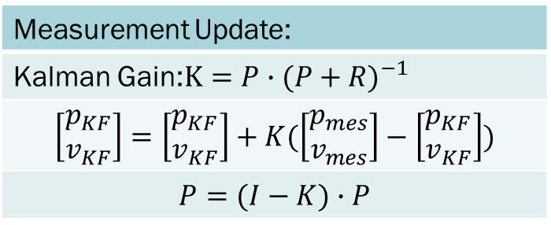
SPT App: State estimator
Kalman Filter for Com speeds and positions
Time Update(Prediction):
$$\left[\begin{matrix}p_{KF} \\ v_{KF}\end{matrix}\right]=A∙\left[\begin{matrix}p_{KF} \\ v_{KF}\end{matrix}\right]+B[a]$$
$$P=A∙P∙A^{T}+B∙Q∙B^{T}$$
Measurement Update:
Kalman Gain:$K=P∙{(P+R)}^{−1}$
$$\left[\begin{matrix}p_{KF} \\ v_{KF}\end{matrix}\right]=\left[\begin{matrix}p_{KF} \\ v_{KF}\end{matrix}\right]+K(\left[\begin{matrix}p_{mes} \\ v_{mes}\end{matrix}\right]−\left[\begin{matrix}p_{KF} \\ v_{KF}\end{matrix}\right])$$
$$P=(I−K)∙P$$
$p_{KF}=$ $p_{KF}$+ $v_{KF}∗∆t+\frac{1}{2}a{∆t}^{2}$
$v_{KF}$ = $v_{KF}$+ $a∆t$
Notes:
1 min
What is Kalman filter
-a linear optimal estimator to estimate states and update by measurements with noisy.
-two parts:
Prediction: model is the motion with an acceleration
Measurement: equations
How to get measurement:
-we cannot get it directly
-calculate

Slide 11
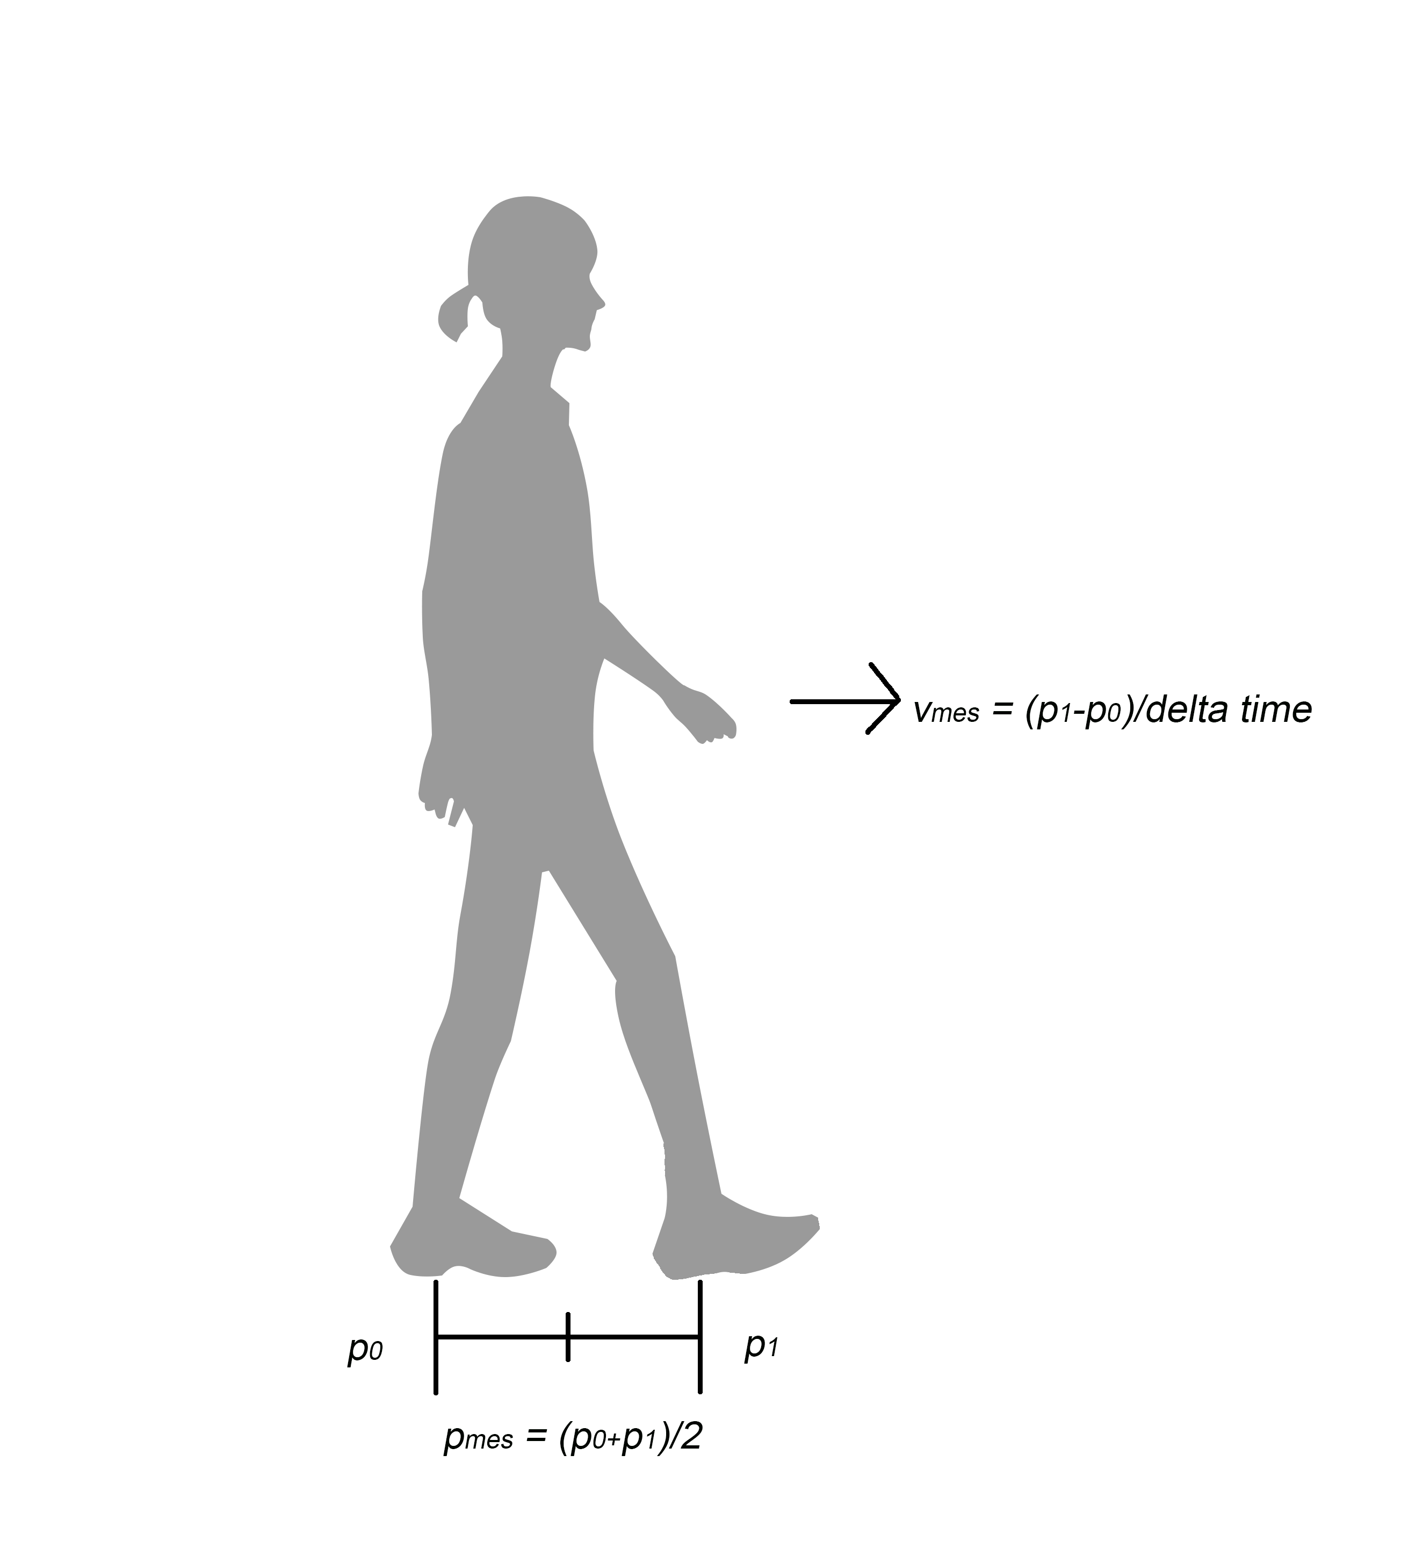
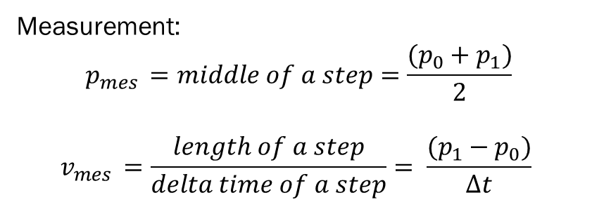
SPT App: State estimator
Kalman Filter for Com speeds and positions
#add a explain plot here
Measurement:
$$p_{mes }=middle of a step=\frac{(p_{0}+p_{1})}{2}$$
$$v_{mes }=\frac{length of a step}{delta time of a step}= \frac{(p_{1}−p_{0})}{∆t}$$
Notes:
1 min

Slide 12
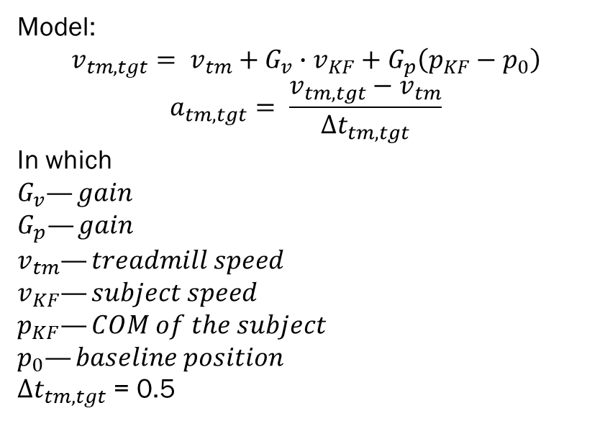
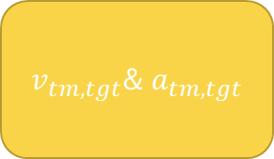

SPT App: Speed Controller
Treadmill speed
$p_{KF}$& $v_{KF}$
Kalman filter
Speed Controller
Model:
$$v_{tm,tgt}= v_{tm}+G_{v}∙v_{KF}+G_{p}\left(p_{KF}−p_{0}\right)$$
$$a_{tm,tgt}= \frac{v_{tm,tgt}−v_{tm}}{∆t_{tm, tgt}}$$
In which
$$G_{v}—gain$$
$$G_{p}—gain$$
$$v_{tm}—treadmill speed$$
$$v_{KF}—subject speed$$
$$p_{KF}—COM of the subject$$
$$p_{0}—baseline position$$
$∆t_{tm, tgt}$ = 0.5
Speed Controller
$v_{tm,tgt}$& $a_{tm,tgt}$
Notes:
1min

Slide 13
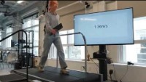
SPT App
Notes:
1min

Slide 14
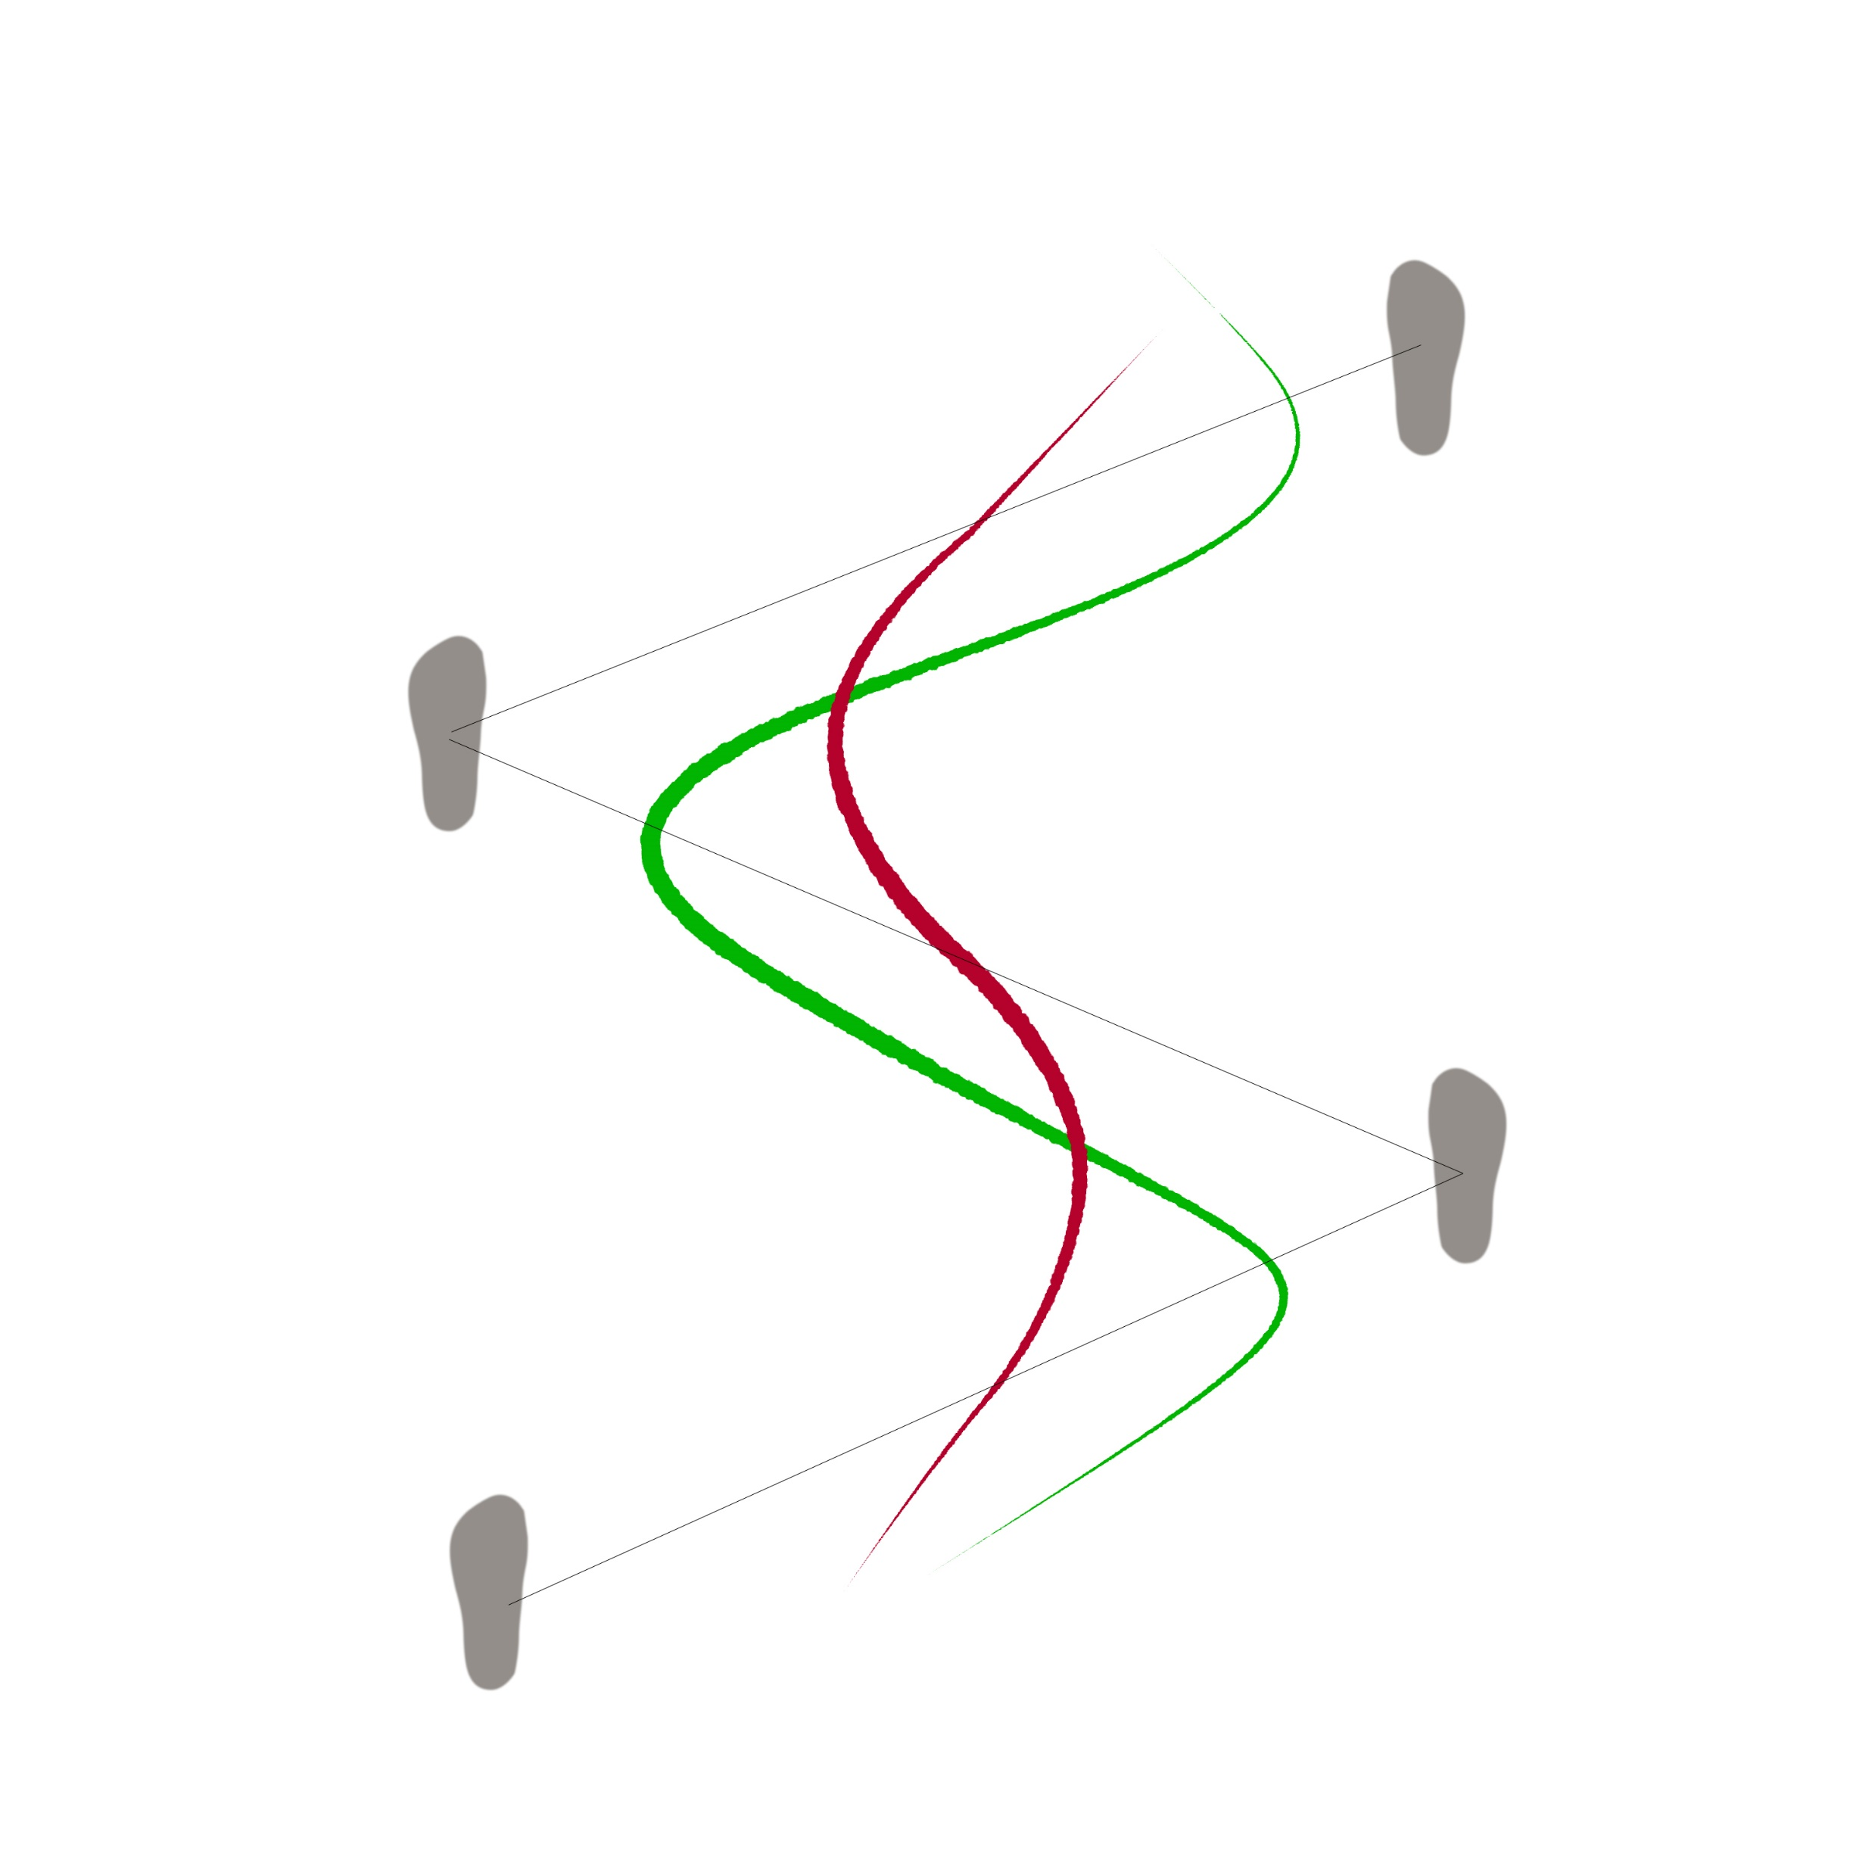
Lateral COM tracking
Green line: true COM trajectory
Red line: fake COM trajectory
Lateral Kalman Filter( Sliding Window)
Prediction Model: Movement with acceleration
Measurement Update: A lateral kinetic COM model
How to estimate lateral COM?
-estimate lateral COM by the relationship between two lines
Result of the model:
-averaged lateral COM: sliding window Kalman filter with last three states
-speed of averaged lateral COM

Slide 15
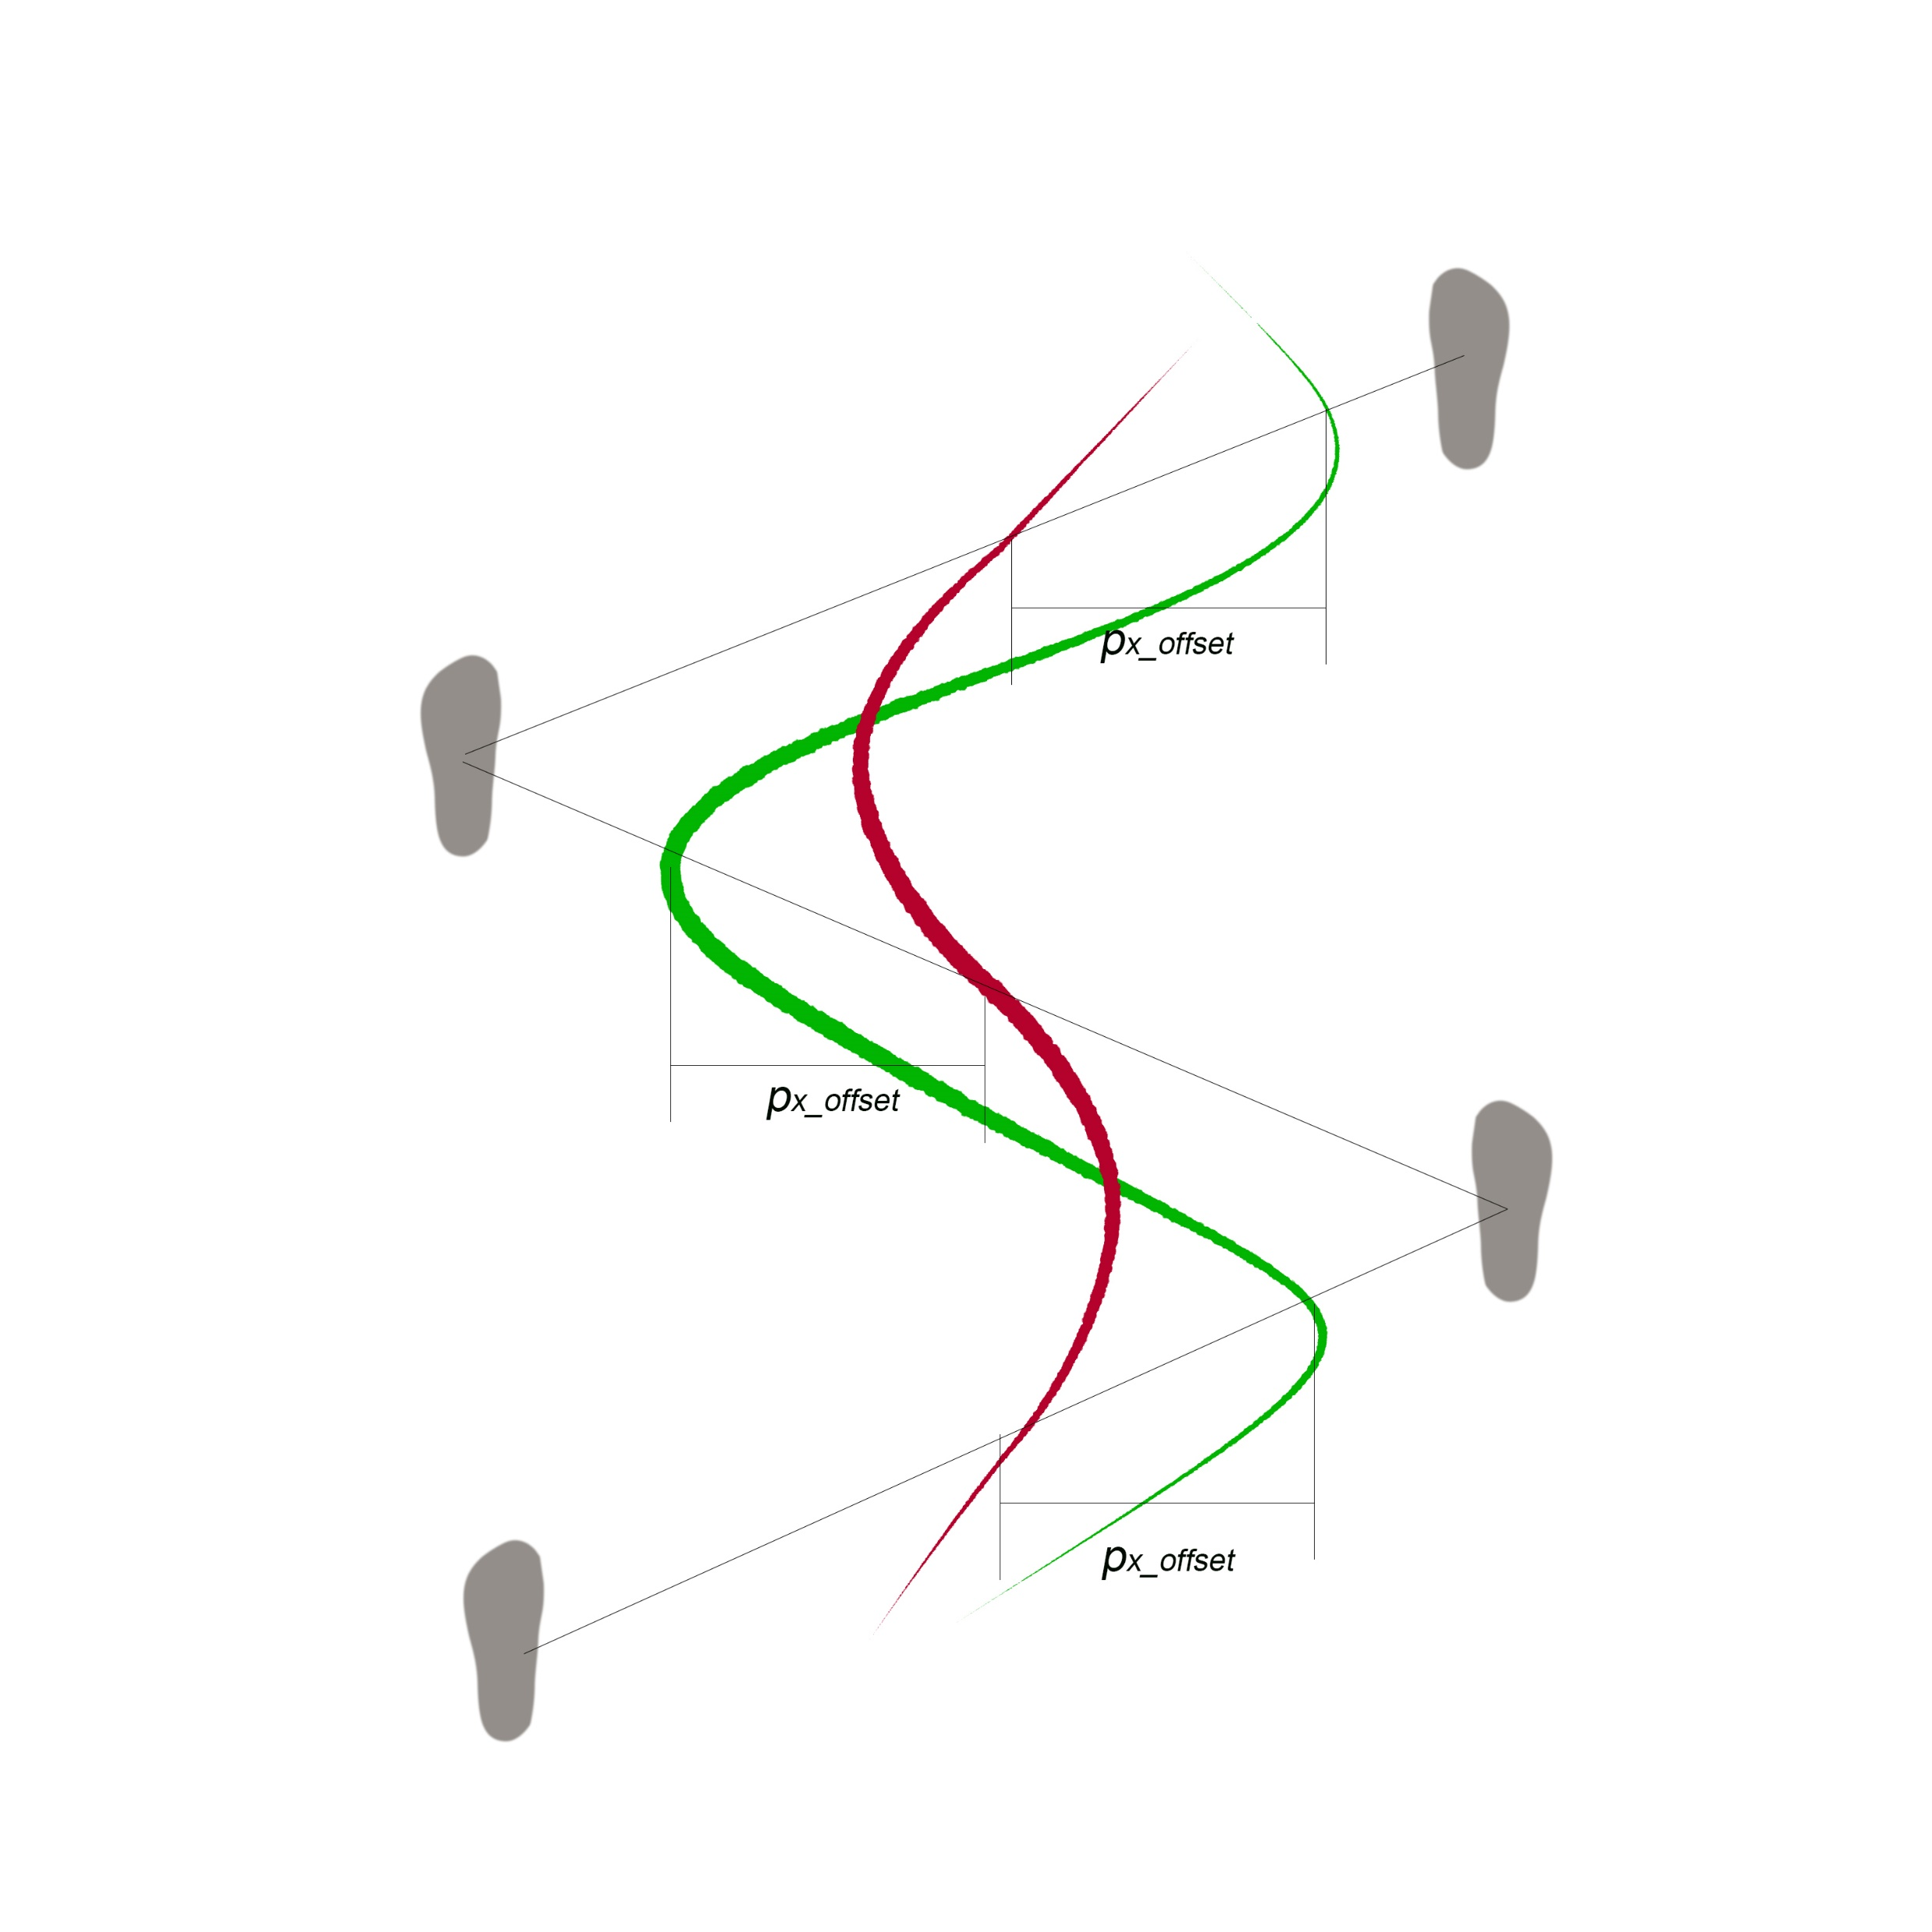

Lateral COM tracking
Lateral Kalman Filter( Sliding Window)
Details of the model:
-hypothesis
-the averaged COM of the true COM trajectory
-the relationship of the averaged COM between two lines
-geometry calculation of the averaged COM
A hypothesis: ${|p}_{x_offset}|=a unique constant$

Slide 16
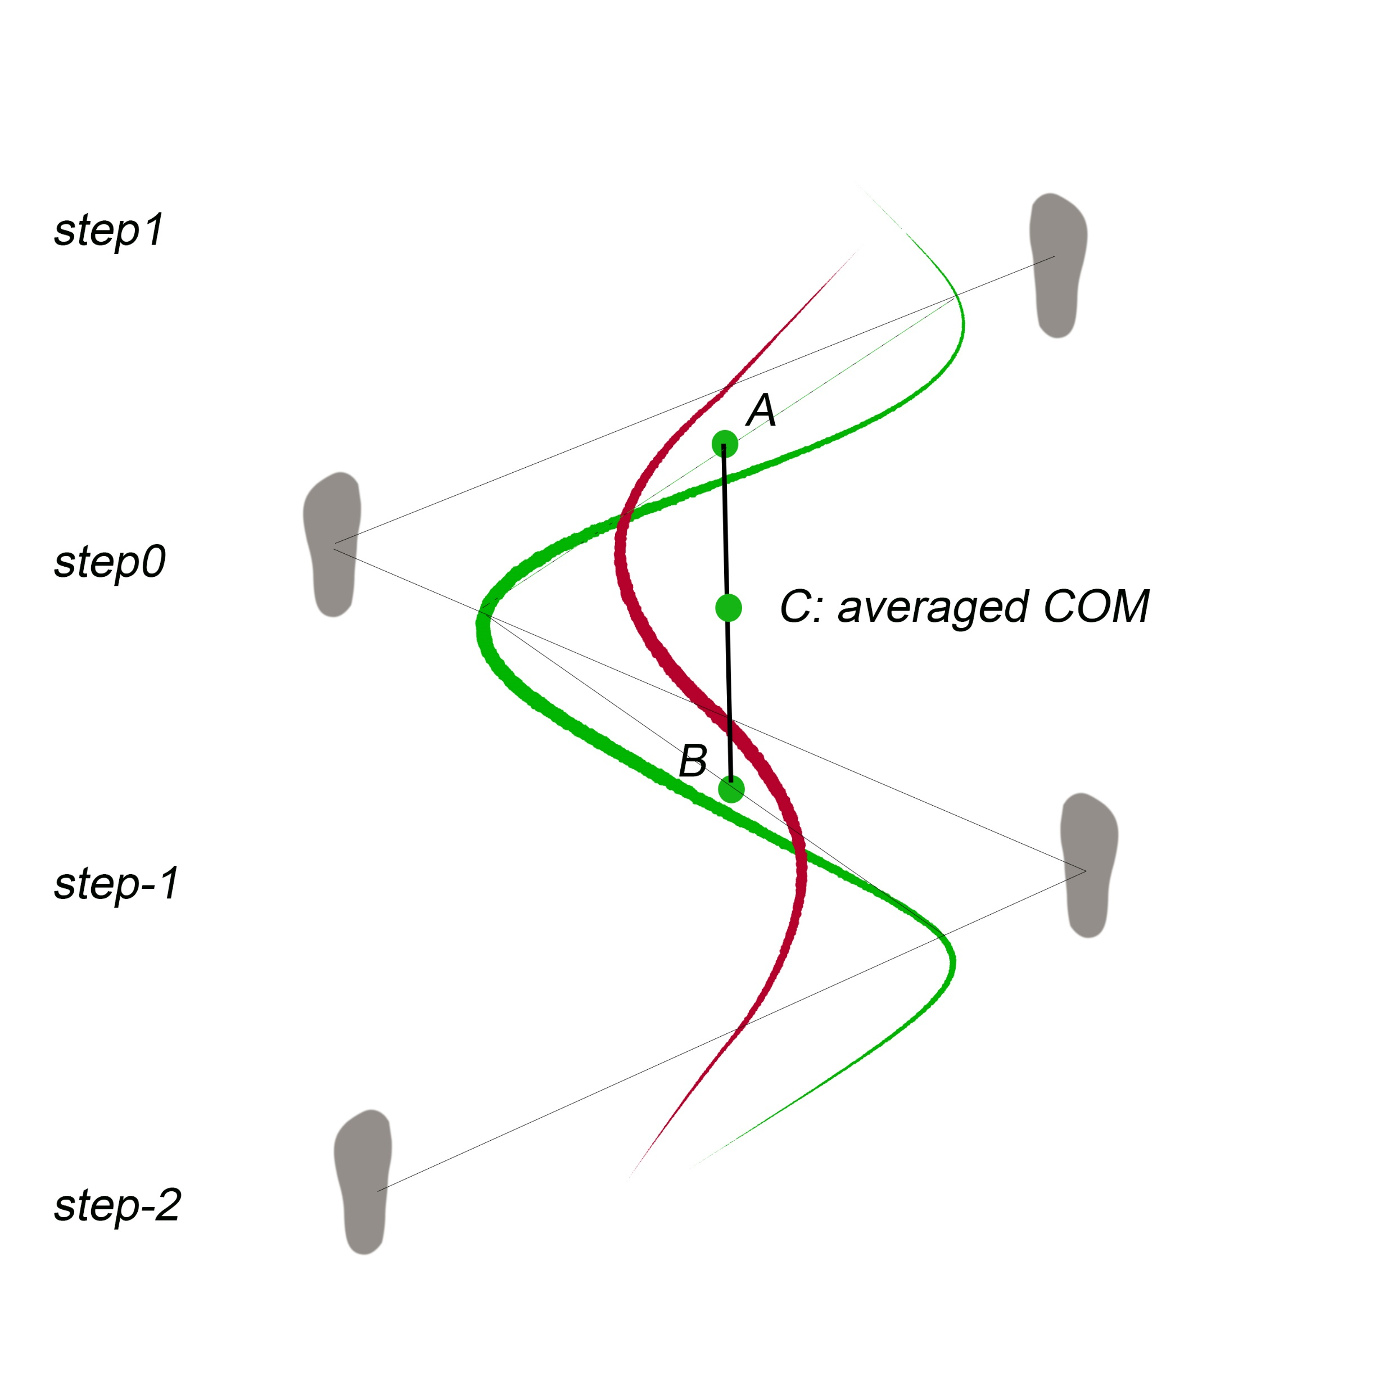
Lateral COM tracking
Details of the model:
-hypothesis
-the averaged COM of the true COM trajectory
-the relationship of the averaged COM between two lines
-geometry calculation of the averaged COM
Notes:
Because we don’t know the offsets so we want to find a way to cancel the offsets.
Average two curves to two points and these two points can cancel out each other.
Don know the real curve so we choose the middle points of two lines and average A and B as a point which is C to represent the averaged COM

Slide 17
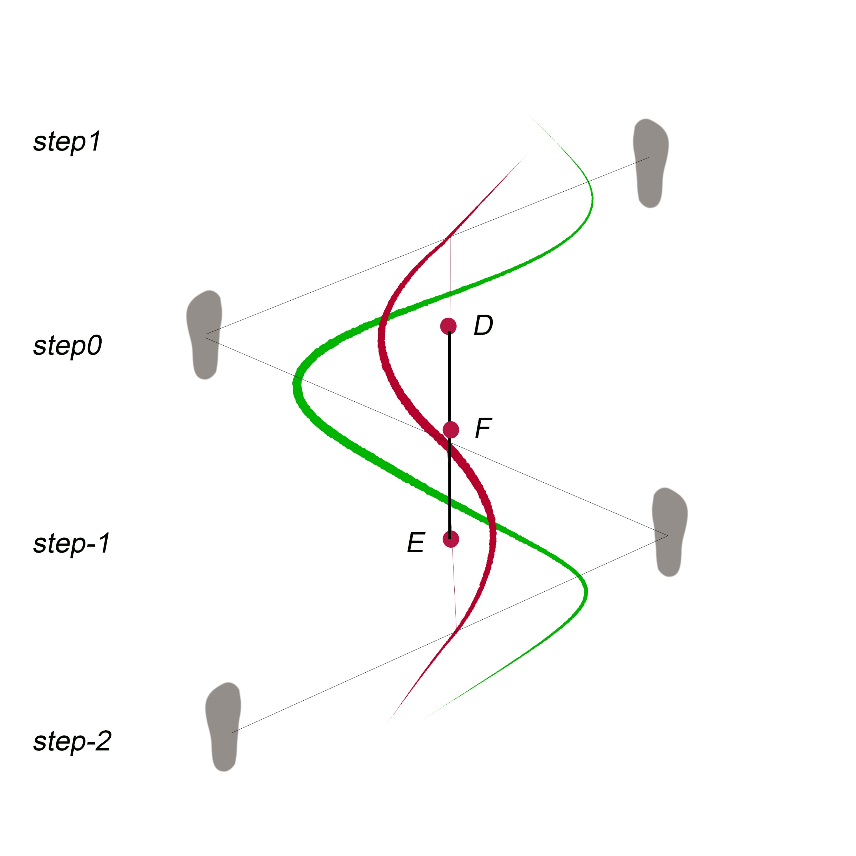
Lateral COM tracking
Details of the model:
-hypothesis
-the averaged COM of the true COM trajectory
-the relationship of the averaged COM between two lines
-geometry calculation of the averaged COM
Notes:
We only have the middle point of each step by cop calculation
Do the same thing to the fake COM trajectory
F and C is on the same vertical line which means the Lateral COM of F and C are the same

Slide 18
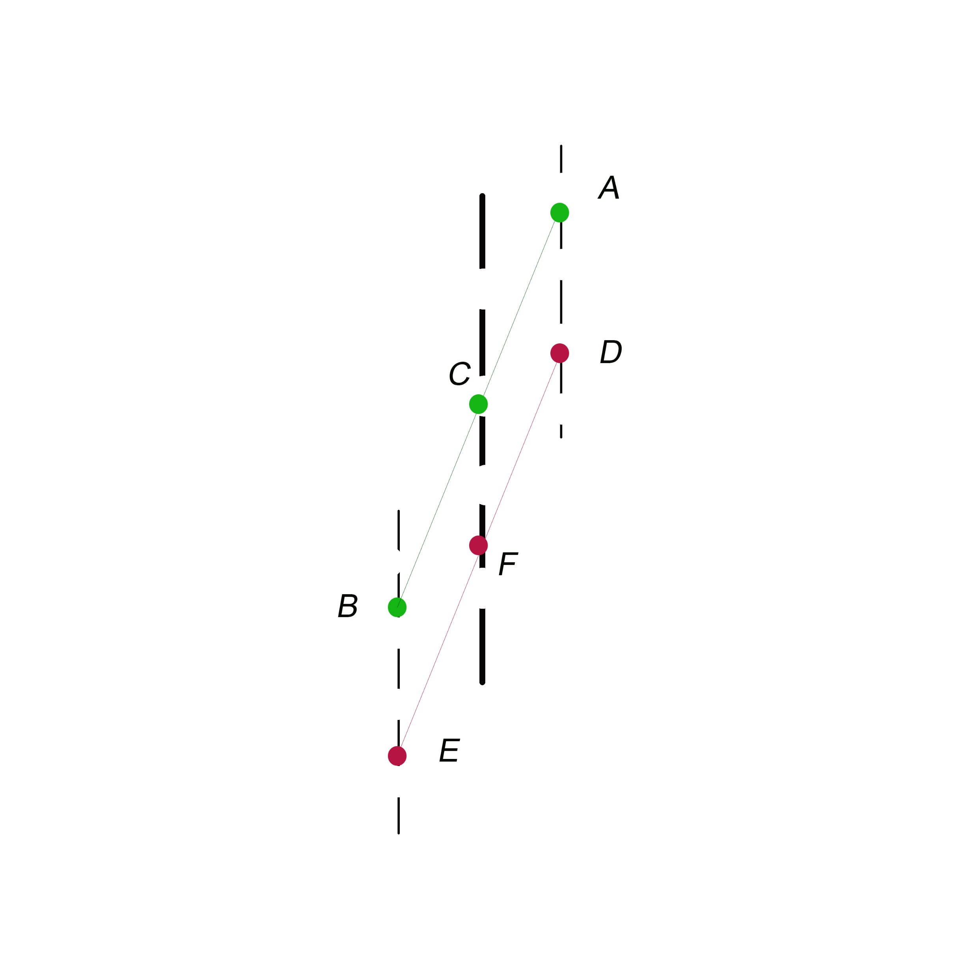
Lateral COM tracking
What conditions cause F and C are on the same vertical line?
-similar quadrilateral
ne
Notes:
What we have now:
C and F are the middle point. Suppose C and F are on a vertical line.
Based on similar triangle rules(, line AD and Line BE should be vertical lines.

Slide 19
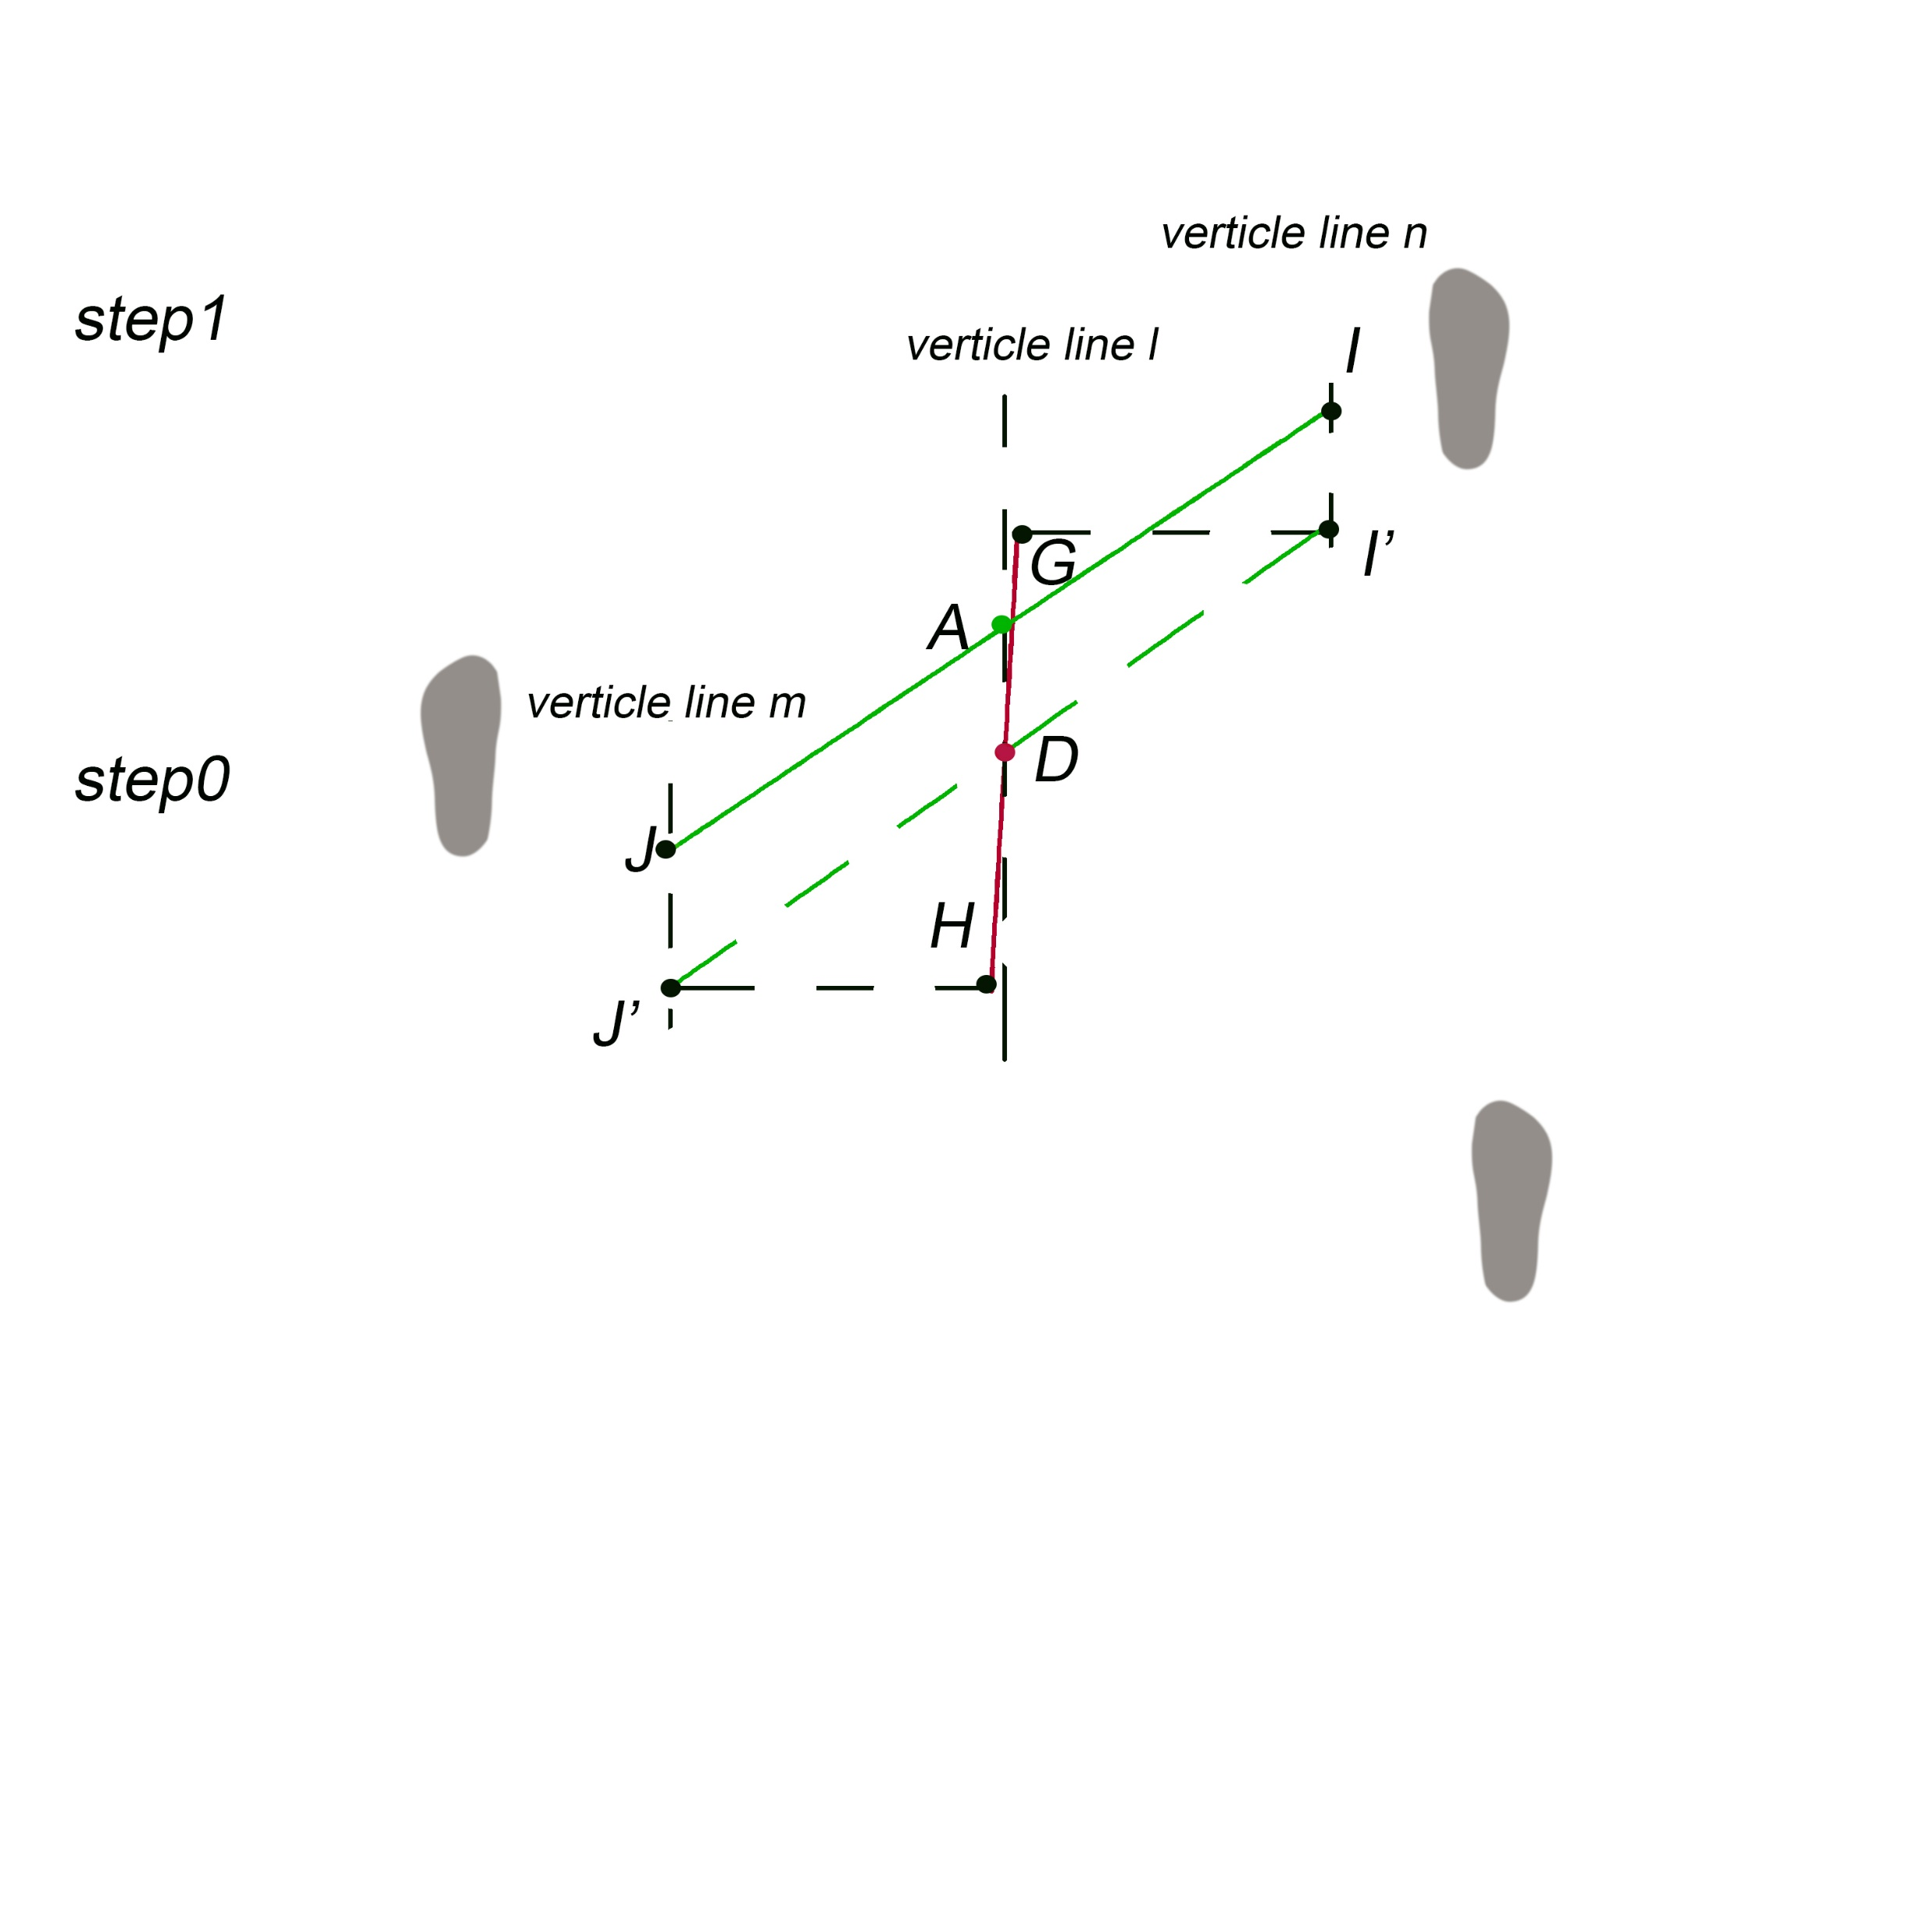
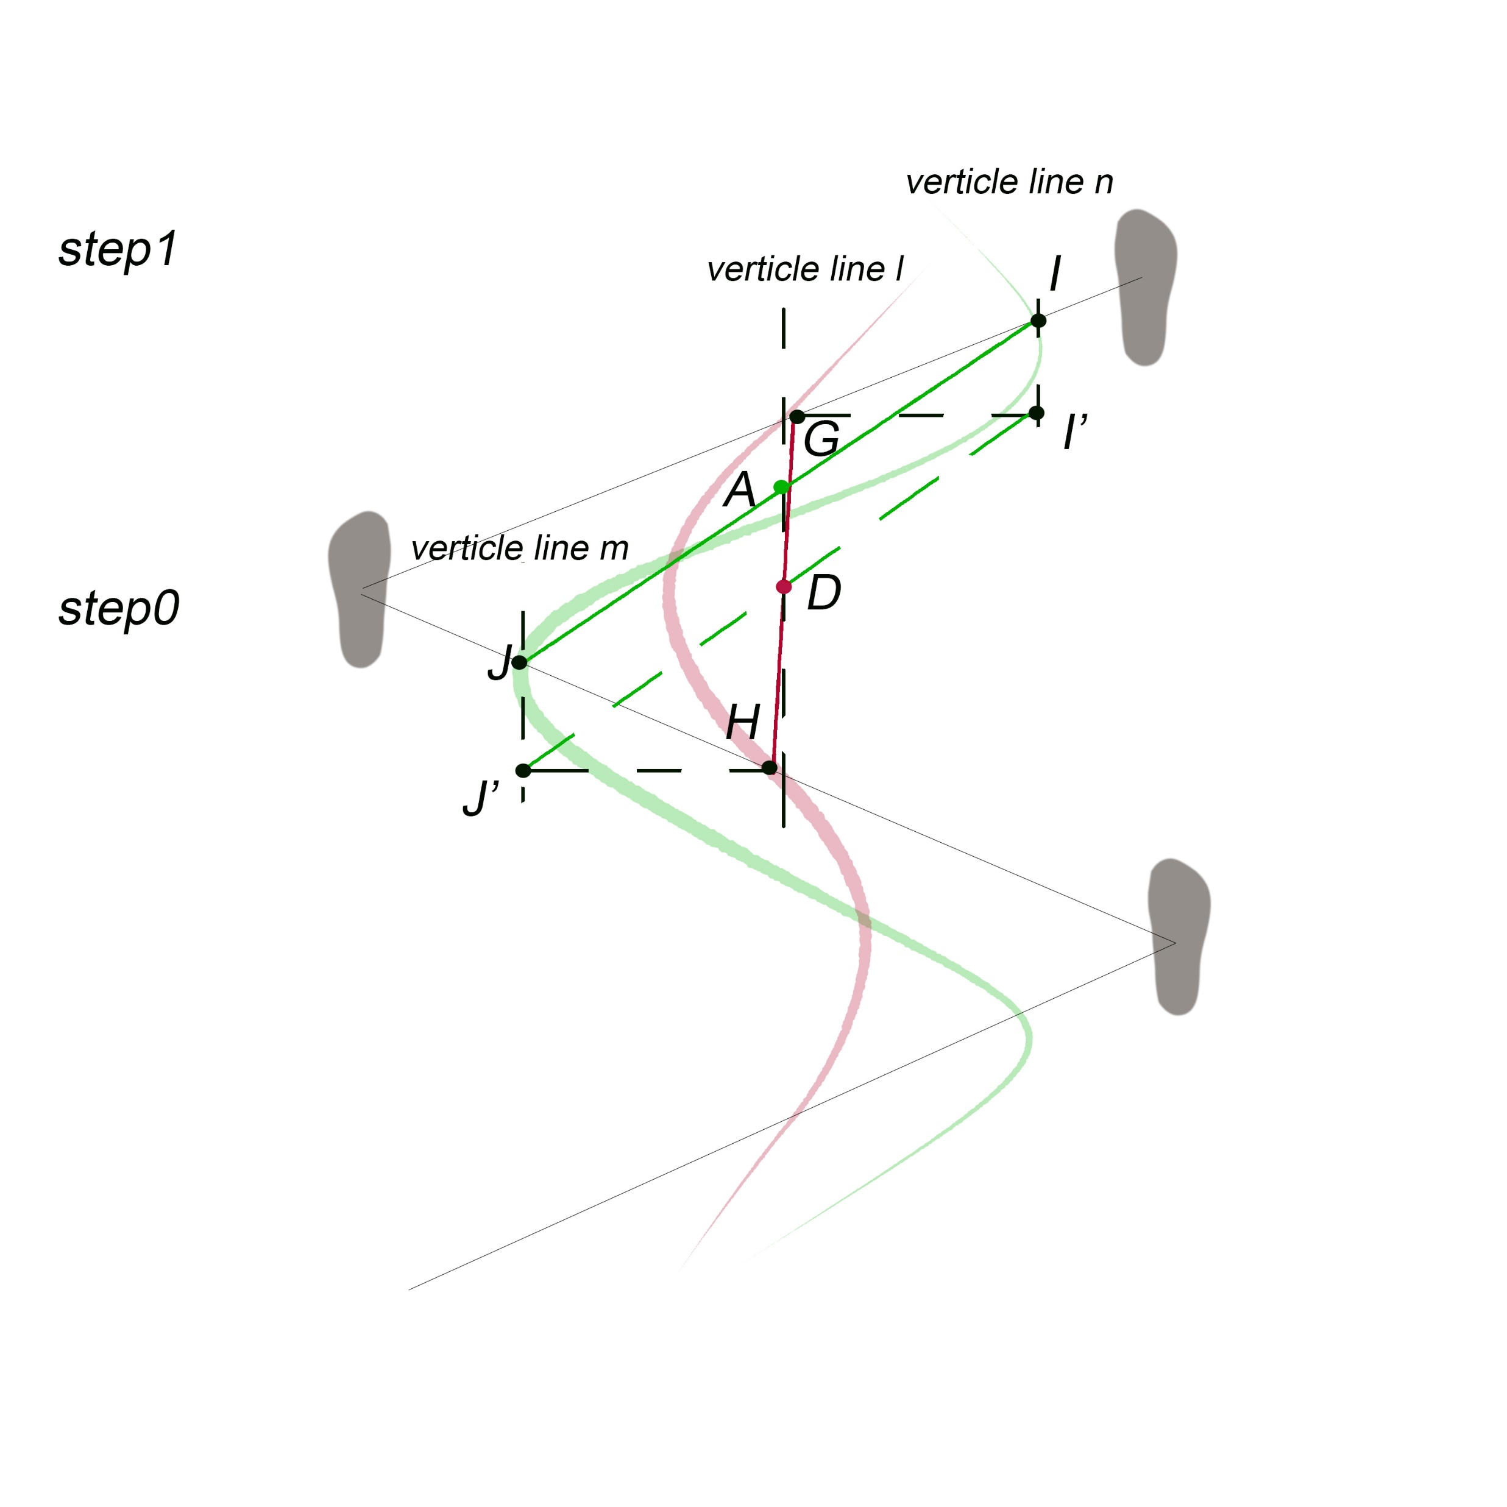
Lateral COM tracking
Notes:
Prove A and D are in the same vertical line
-G and H is the middle point of each step, I and J are the true COM with offset, Gi’=J’H because of the hypothesis, A and D are the middle point of IJ and GH
-triangle GDI’=DHJ’->D is the middle point of J’I’
-II’ is parallel to JJ’, based on similar quadrilateral rules, vertical line l is parallet to vertical line m. so AD are on the same vertical line.

Slide 20
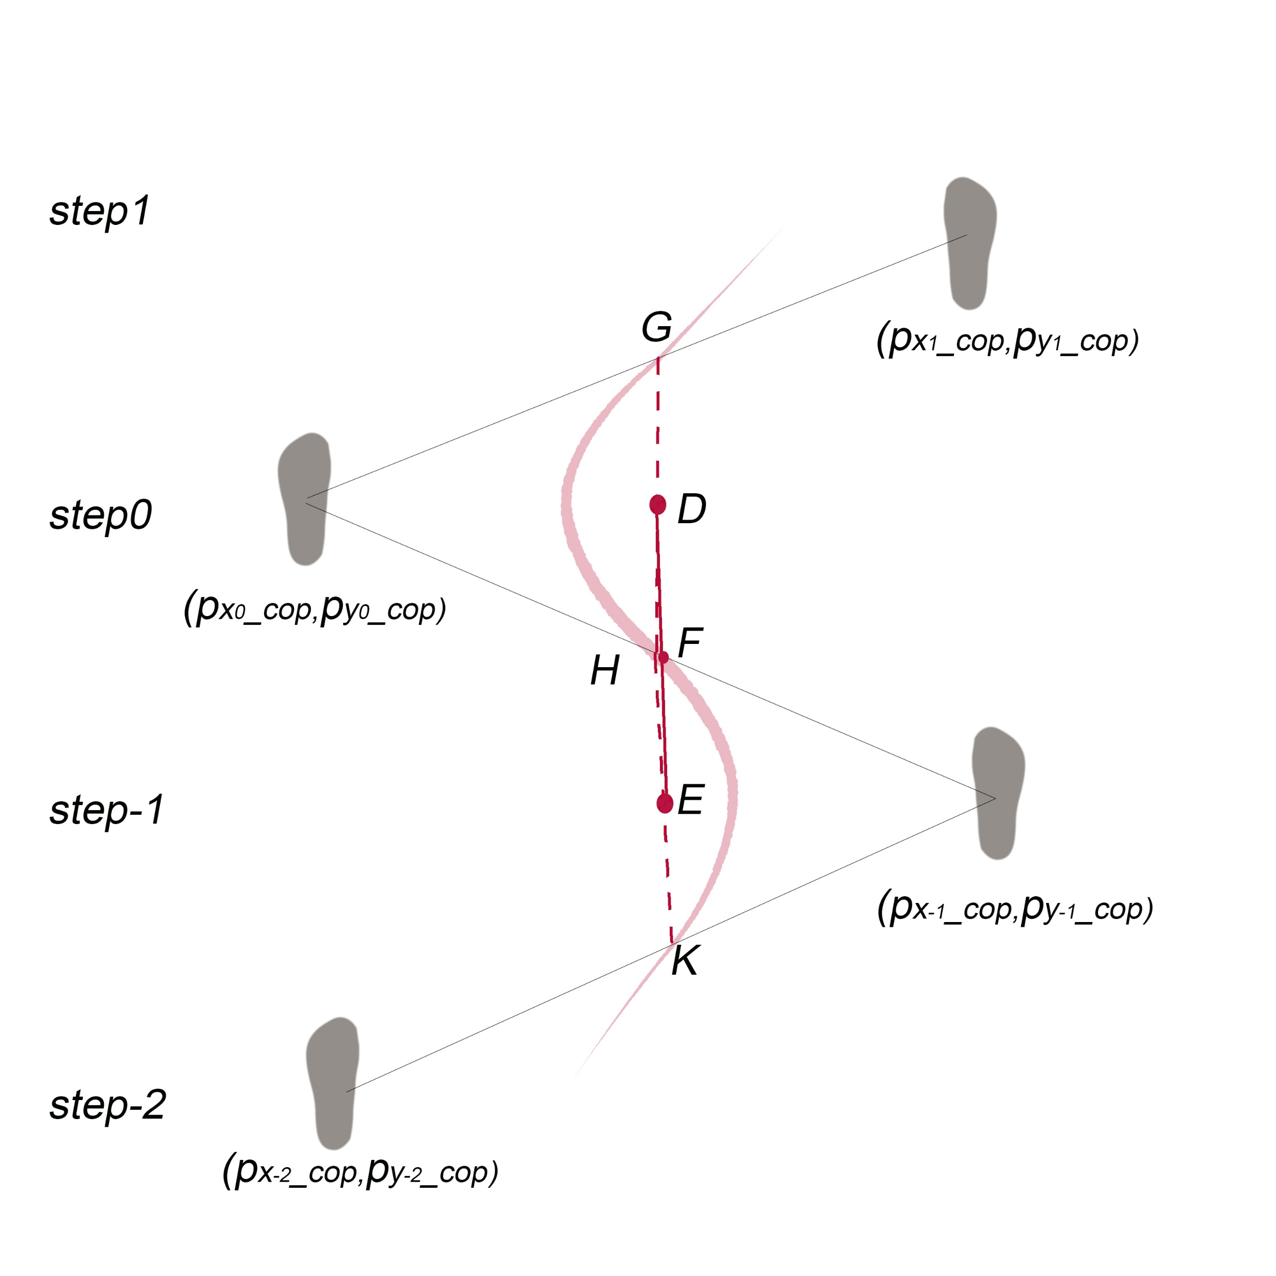
Lateral COM tracking
Details of the model:
-geometry calculation of the averaged COM
Notes:
7 mins

Slide 21
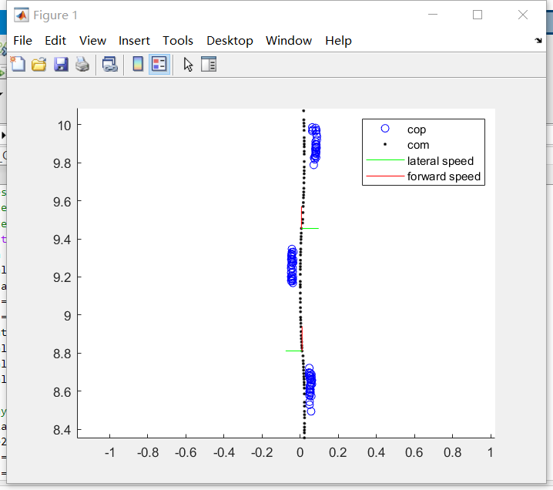
Lateral COM tracking

Slide 22
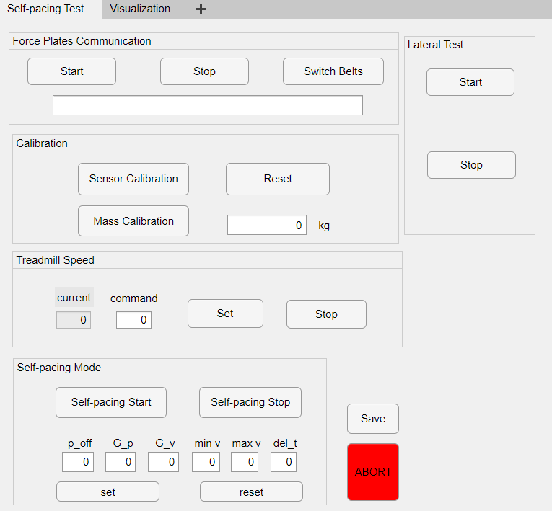
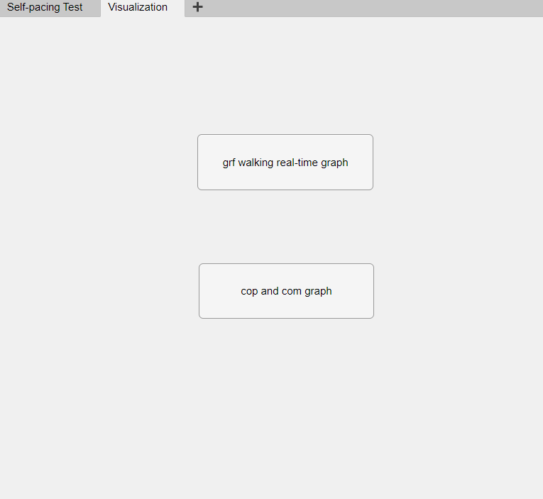
SPT App: GUI
MATLAB App Designer
Remaining Problems
Some functions doesn’t work
Break down
MATLAB Support
Notes:
8 min

Slide 23
Thanks

